Slide 1
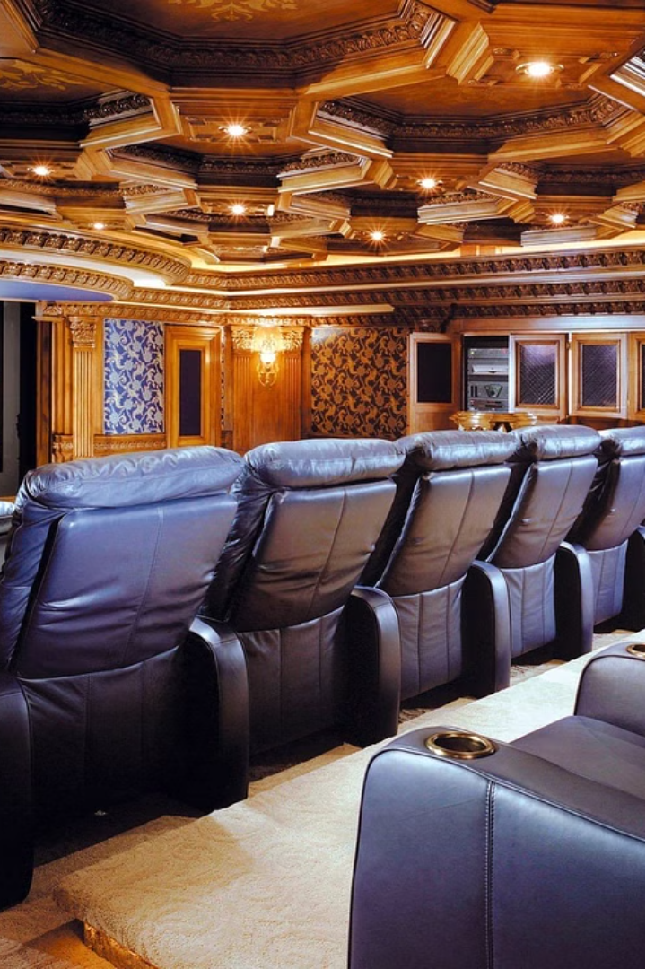

Movie Booking System
This movie booking system allows users to easily search, select, and reserve seats for their desired movie showings. It streamlines the booking process, providing a smooth experience for both movie fans and theater operators.

Slide 2
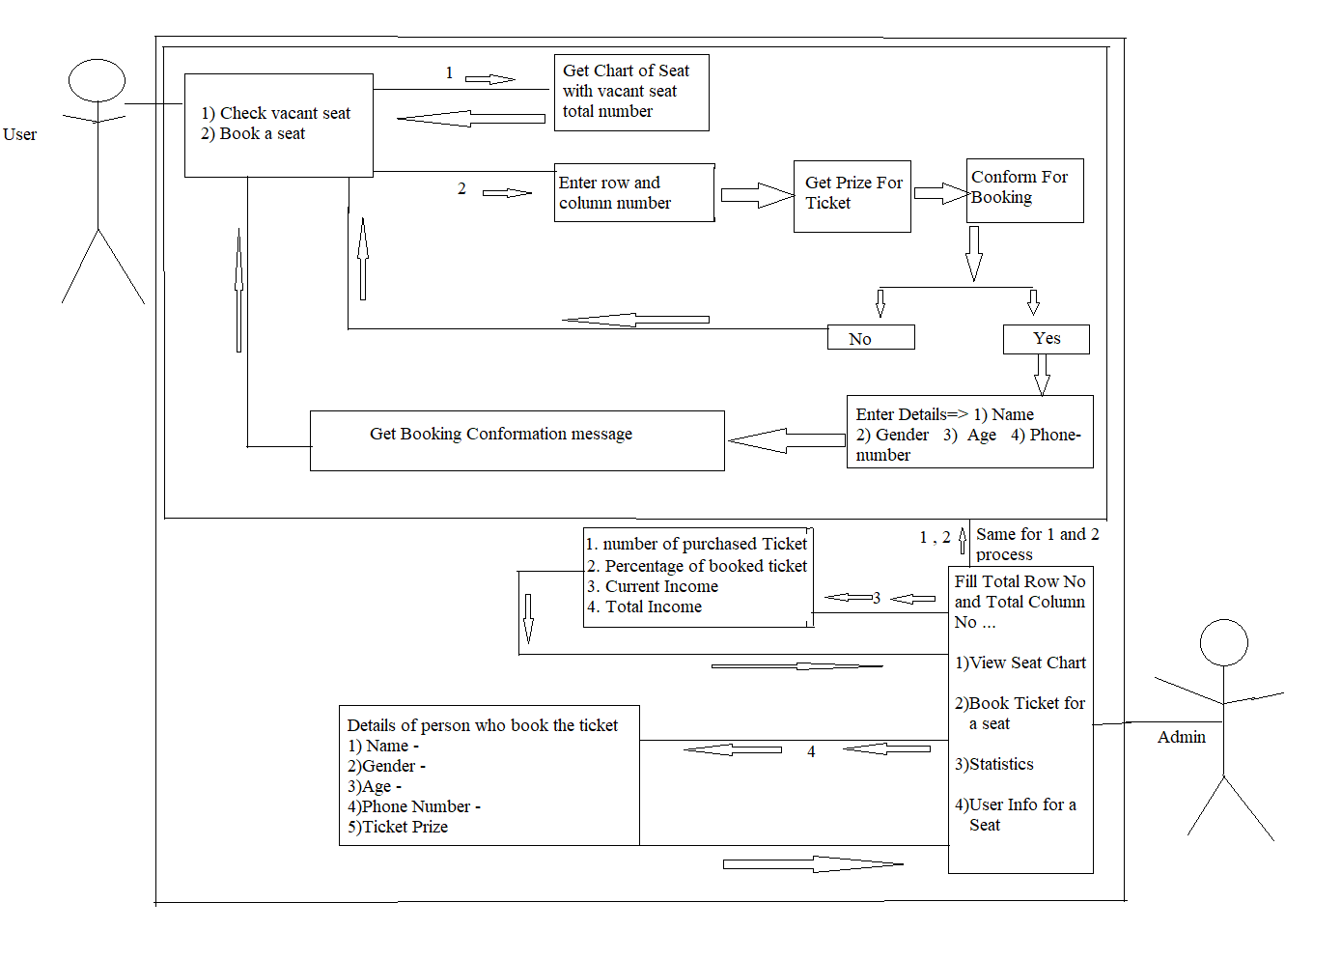
Use Case Diagram

Slide 3

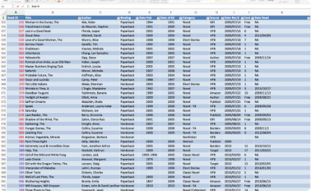
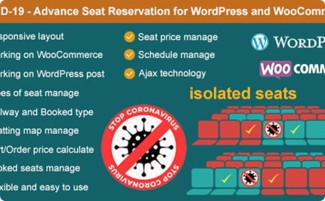
Database Design and Implementation
User Data
Movie Listings
Reservation Management
The system stores user information, including their personal details and booking history, to provide a personalized experience.
The database holds comprehensive data on available movies, showtimes, and seating information to enable efficient booking.
The system tracks and manages seat reservations, ensuring real-time availability and preventing double-bookings.

Slide 4
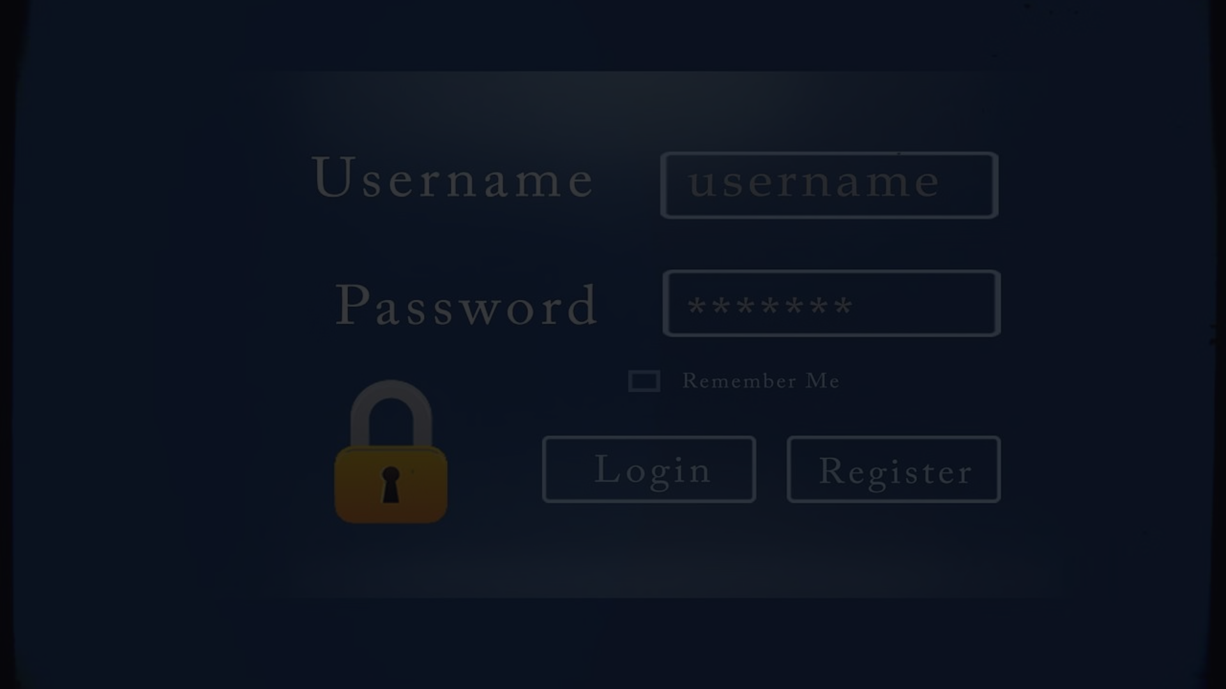
User Login and Authentication
1
Secure Login
2
Multi-Factor Authentication
Users can create an account with their personal information, which is securely stored in the database.
The system employs robust authentication measures, such as passwords to protect user accounts.

Slide 5
Movie Listing and Selection
Comprehensive Catalog
Detailed Information
The system offers a wide selection of movies, allowing users to browse and filter by genre, rating, and showtimes.
Users can access detailed movie descriptions, cast information, and reviews to help them make informed choices.
Seat Availability
Ticket Pricing
The system displays real-time seat availability for each movie, enabling users to select their preferred seats.
The system provides transparent pricing information, including any discounts or promotions, to ensure a seamless booking experience.

Slide 6
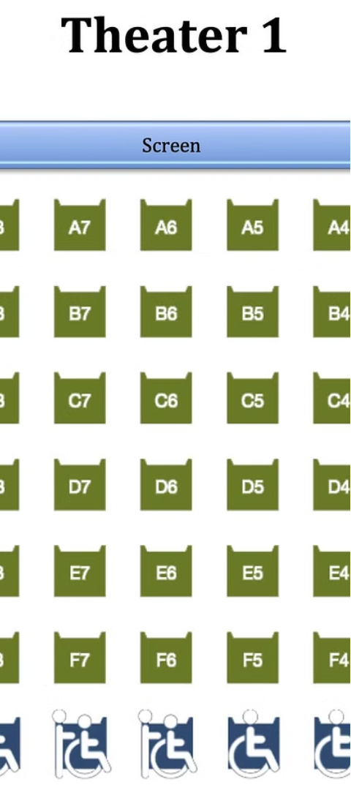
Seat Booking and Reservation
1
Select Seats
Users can choose their preferred seats from the available options, with a visual representation of the theater layout.
2
Confirm Booking
The system guides users through the booking process, allowing them to review and confirm their selections.
3
Secure Payment
Users can securely complete their booking by making the necessary payment, with options for various payment methods.

Slide 7



Booking History and Ticket Management
Booking History
Digital Tickets
Ticket Modifications
Users can access their complete booking history, allowing them to review past reservations and manage their tickets.
The system provides users with mobile-friendly digital tickets, which can be easily accessed and scanned at the theater.
Users can manage their bookings, including the ability to cancel, exchange, or request refunds for their tickets.

Slide 8
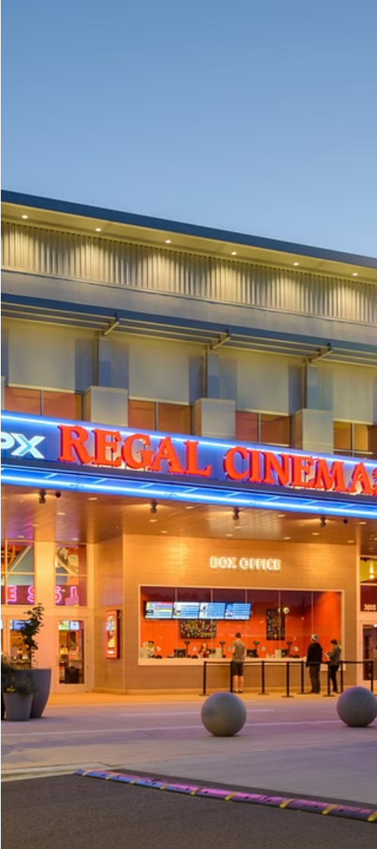



Conclusion and Future Enhancements
Optimized Experience
The movie booking system delivers a seamless, user-friendly experience that caters to the evolving needs of movie-goers.
Continuous Improvements
The platform is designed for scalability, with plans to incorporate additional features and functionalities based on user feedback.
Enhancing the Future
The movie booking system aims to redefine the way people discover, book, and enjoy their cinematic experiences.

